Slide 1
Book Store Project using List and Dictionary objects of python
Project Description
Dr Venkata Raju

Slide 2
Create a console-based bookstore system that allows users to:
The three main features are as follows:
-Enter and retrieve book details
-Mark books as read (meaning they’ve finished reading them)
- Delete existing books

Slide 3
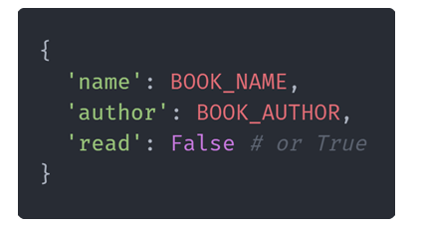
What are books?
You can define their structure to be anything you like, but here is my proposed structure:

Slide 4
Marking books as read
The property read of each book should be a boolean.
When a user wants to mark a book as read, we first should ask them for the name of the book they’ve read.
Then, loop through all the books and set the read property to True if the book name matches what the user typed.

Slide 5
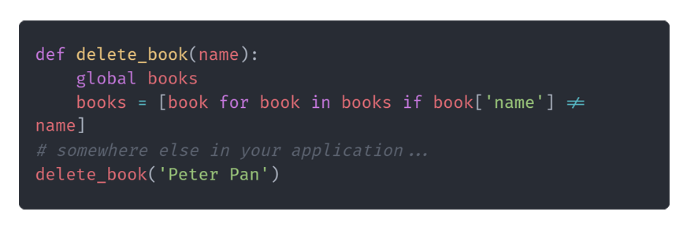
Deleting books
You can use a list comprehension to re-create the books list without the book that the user typed.

